Slide 1

Hard work VS Smart work
By-Aditya Borhade

Slide 2
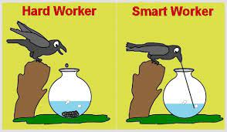

INTRODUCTION
“In the pursuit of success and efficiency, individuals often face a choice between hard work and smart work.“
Which one do you think is better?

Slide 3

Hard work
"Hard work refers to putting in significant effort, time, and energy to achieve a goal."

Slide 4

Smart Work
"Smart work involves finding efficient and effective ways to achieve the same goal with less effort and in less time."

Slide 5

Advantages and Disadvantages of hard work
Advantages:
Disadvantages:
Highlight the benefits of hard work:
Demonstrates dedication and commitment.
Often results in a deep understanding of the task.
Builds discipline and perseverance
.
Discuss the drawbacks of relying solely on hard work:
Might not be scalable in the long run.
Can lead to burnout and exhaustion.
May not always lead to optimal results
.

Slide 6
Advantages and Disadvantages of Smart work
Advantages:
Disadvantages:
Emphasize the benefits of smart work:
Focuses on efficiency and productivity.
Utilizes strategies to achieve goals faster.
Promotes innovative thinking and problem-solving
Discuss the potential downsides of relying solely on smart work:
Might overlook important details or steps.
Can sometimes appear as cutting corners.
May not be suitable for tasks that require thoroughness.
.

Slide 7

CONCLUSION
Ultimately, the key to success is finding the right balance between hard work and smart work.
By setting clear goals, developing a plan, prioritizing tasks, leveraging technology, and embracing continuous learning, we can maximize our productivity and achieve our goals more efficiently.

Slide 8
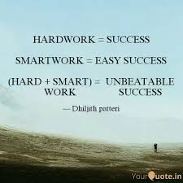
THANK YOU!
13

